Slide 1
Data Exploration Challenge
Group Members:
Hassan Shahzad
Sarah Tayyab

Slide 2
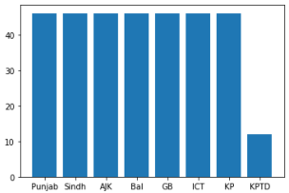
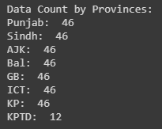
Data Cleansing
The dates recorded were not in the same format in order to deal with the data it had to converted to the same format.
The number of data gathered per region was not the same since KPTD has data gathered from 11 March till 22 March irrespective of other regions.

Slide 3
Data Cleansing Continued
From 23 April 2020, 2 columns had wrong data entries which were:
Discharged Column entries were replaced with Home Quarantine 2nd column entries.
Home Quarantine 1st column entries were replaced with Admitted Ventilator entries.
How it was solved:
Discharged patients were actually those who had recovered from corona virus so it was replaced with entries of Recovered as both the fields had the same entries before 23 April.
Home Quarantine 1st column entries were corrected by replacing it with parallel Home Quarantine 2nd column as both the columns had the same entries before 23 April.

Slide 4
Same Metric & KPTD Problem
Same Metric:
Since different regions had different population so in order to compare respective regions each region population was divided by million so that uniformity in the data was achieved.
Problem Of KPTD:
Since KPTD was only in the time span during 11 March till 22 March so it was compared to the rest regions only in that phase.

Slide 5
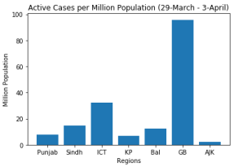
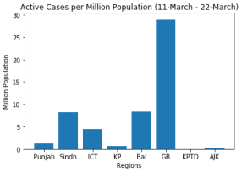
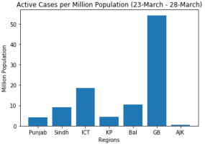
Active Cases of Different Regions in Different phases

Slide 6
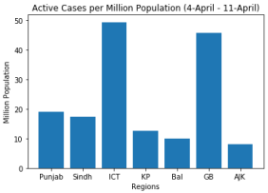
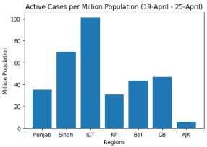
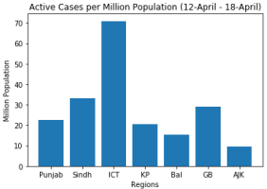
Continued…

Slide 7
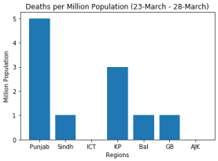
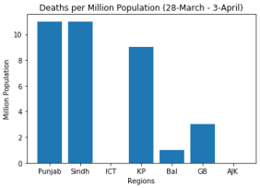
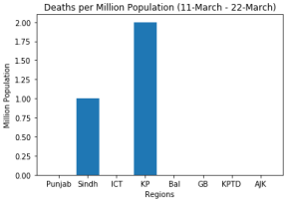
Deaths in Different Regions in Different phases

Slide 8
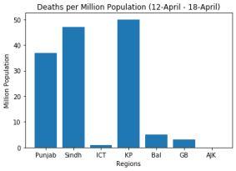
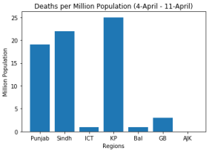
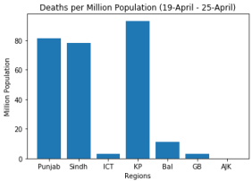
Continued…

Slide 9
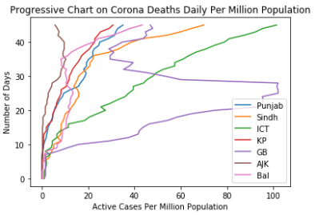
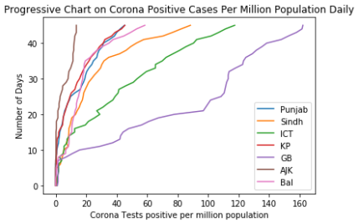
Daily Growth in Corona Cases

Slide 10
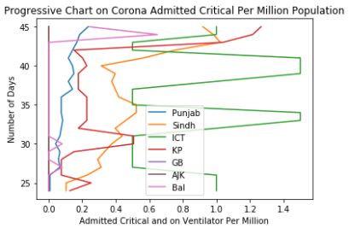
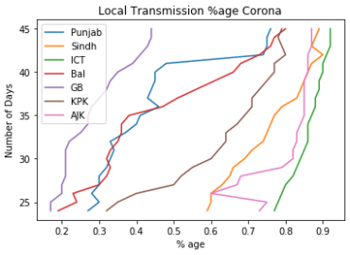
Continued…

Slide 11
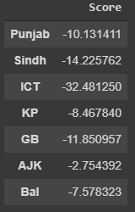
Final Verdict
Considering the scores of each region following are the ratings of the regions:
Regions | Ratings
AJK | Most Successful
Balochistan | Successful
KP | Somewhat Successful
Punjab | Average
GB | Somewhat Struggling
Sindh | Struggling
ICT | Most Struggling

Slide 12
Predictions for the next 10 days using SVM
Region | Day 1 | Day 2 | Day 3 | Day 4 | Day 5 | Day 6 | Day 7 | Day 8 | Day 9 | Day 10
Punjab | 5888.9 | 6270.5 | 6668.6 | 7083.8 | 7516.2 | 7966.2 | 8434.3 | 8920.7 | 9425.8 | 9950.0
Sindh | 4080.6 | 4338.5 | 4607.6 | 4888.1 | 5180.3 | 5484.5 | 5800.8 | 6129.5 | 6470.9 | 6825.1
ICT | 270.2 | 287.1 | 304.8 | 323.2 | 342.4 | 362.4 | 383.1 | 404.7 | 427.1 | 450.4
KP | 1901.0 | 2026.0 | 2156.5 | 2292.5 | 2434.1 | 2581.6 | 2734.9 | 2894.3 | 3059.8 | 3231.6
GB | 222.3 | 215.5 | 208.3 | 201.1 | 194.0 | 187.3 | 181.2 | 175.6 | 170.8 | 166.6
Bal | 667.2 | 711.3 | 757.3 | 805.2 | 855.1 | 907.0 | 961.0 | 1017.2 | 1075.4 | 1135.9
AJK | 74.6 | 79.6 | 84.8 | 90.2 | 95.8 | 101.7 | 107.8 | 114.1 | 120.7 | 127.5

Slide 13
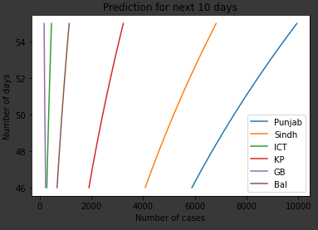
Continued…

Slide 14
Thank You
In the end, I pray May Allah help us in this pandemic and grant us patience.
Furthermore I advise to do everything in accordance with government policies so that instead of the aggravating the situation we are the one ones becoming beneficial for the society. Stay at home and Stay safe.

